Slide 1

Bellabeat Data Analysis
By:
Kevin Ajith
07-09-2023

Slide 2

AGENDA
Objective
About the data
Story from data
Recommendations
Questions

Slide 3

Objective
To analyse User Data for Bellabeat, to answer the following:
Understanding how customers use smart devices
Inform Bellabeat’s marketing strategy for growth
Get insights on key features to include in design of Bellabeat app or product to help with growth

Slide 4

About the data
Data is open-sourced
Data is taken from Zendo
Data was uploaded by MORIUS
Data was downloaded from Kaggle
There are 18 CSV files containing data
The data has 33 unique Ids.
Data contains fields like Intensities, Calories, Steps Taken, Distance Traveled and Sleep.
Data has been measured daily, hourly as well as in minutes.

Slide 5
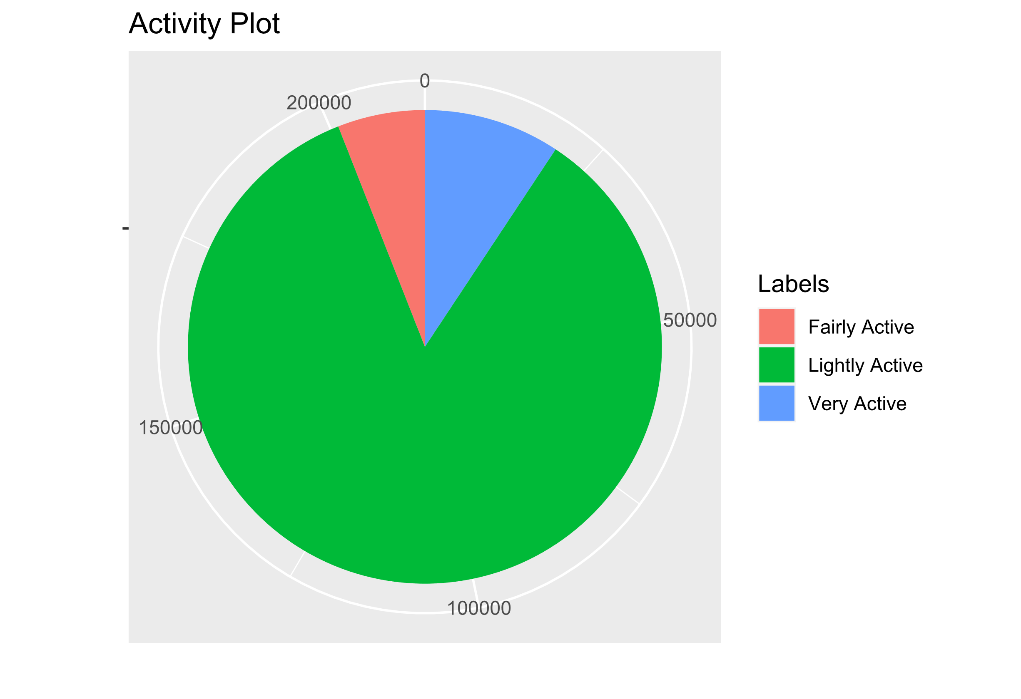
Activity
Majority of the time users do Light Activity.
That is,
Fairly Active = 5.9%
Lightly Active = 84.74%
Very Active = 9.2%

Slide 6
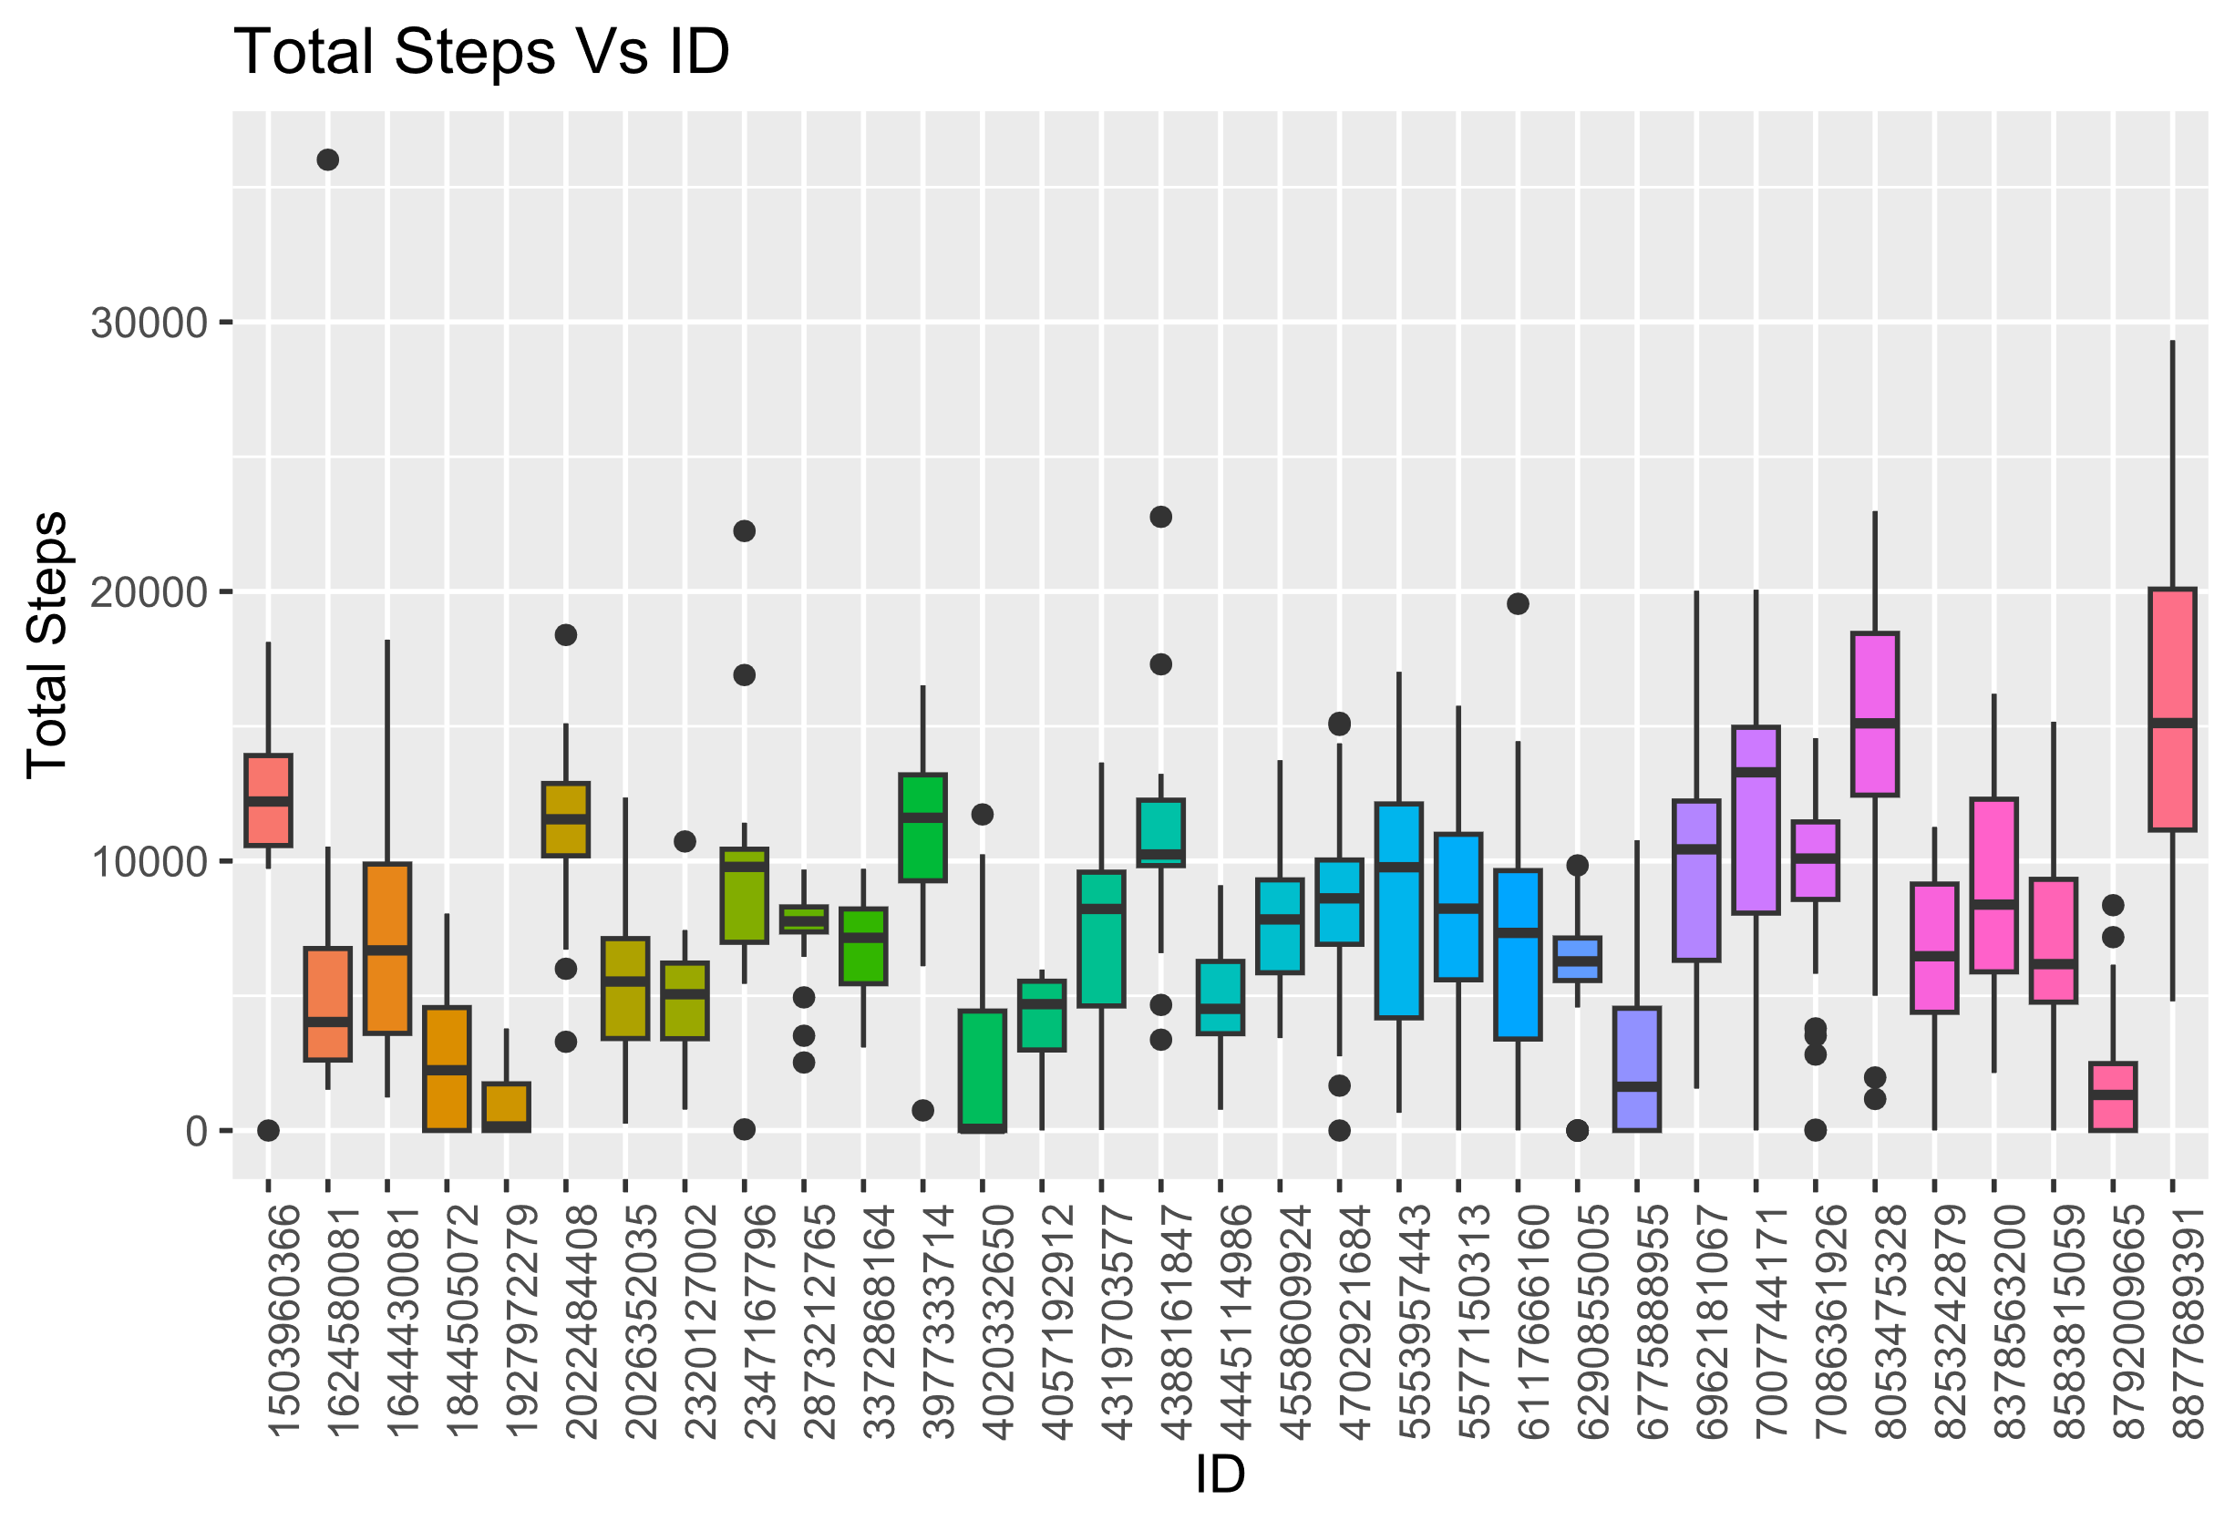
Total Steps
From the above plot we can infer that, most of the users takes less than 10,000 steps on an average daily.

Slide 7
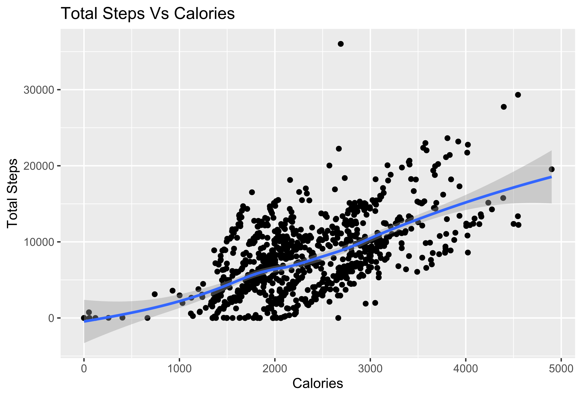
Steps And Calories
The above plot tells us that the TotalSteps has a positive correlation with Calories, i.e, The more steps you take more calories your burn.
It may vary from user to user because of their metabolism.
So, more steps people take more calories they burn.

Slide 8
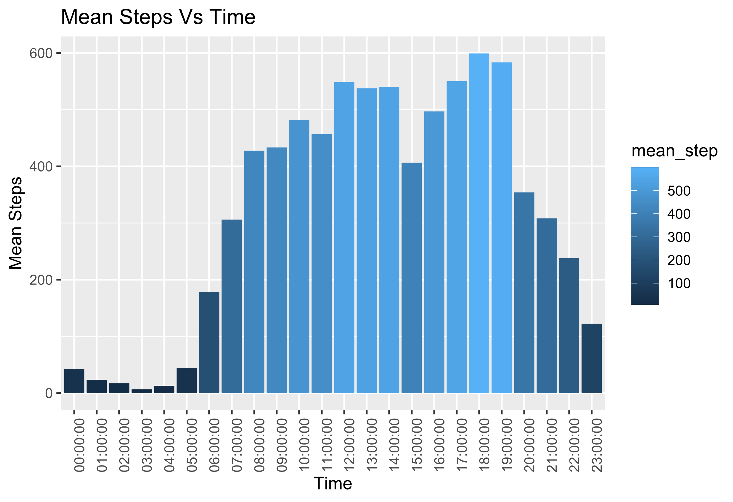
Walk Timings
The average step count highest between 4 PM to 7 PM.
The data also correlates from the time where most of the users sleep.

Slide 9
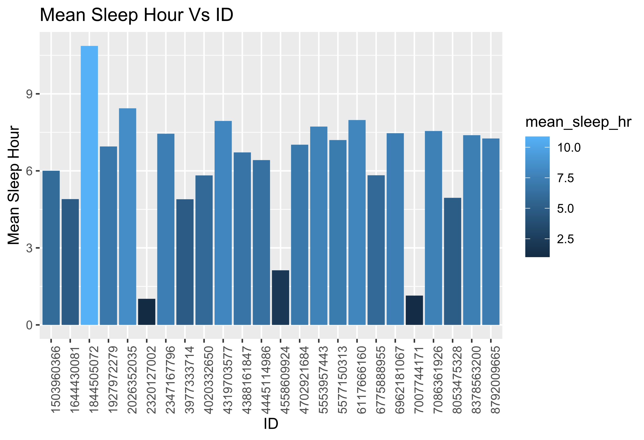
User Sleep
According to the National Sleep Foundation, on an average an adult human requires sleep of 7 to 8 hours.
Though the sample for sleep is available for 24 users only, It can be said that on average they sleep for 6.98 hours, from which we can say that there are users who do not meet the required standard when it comes to sleep.

Slide 10
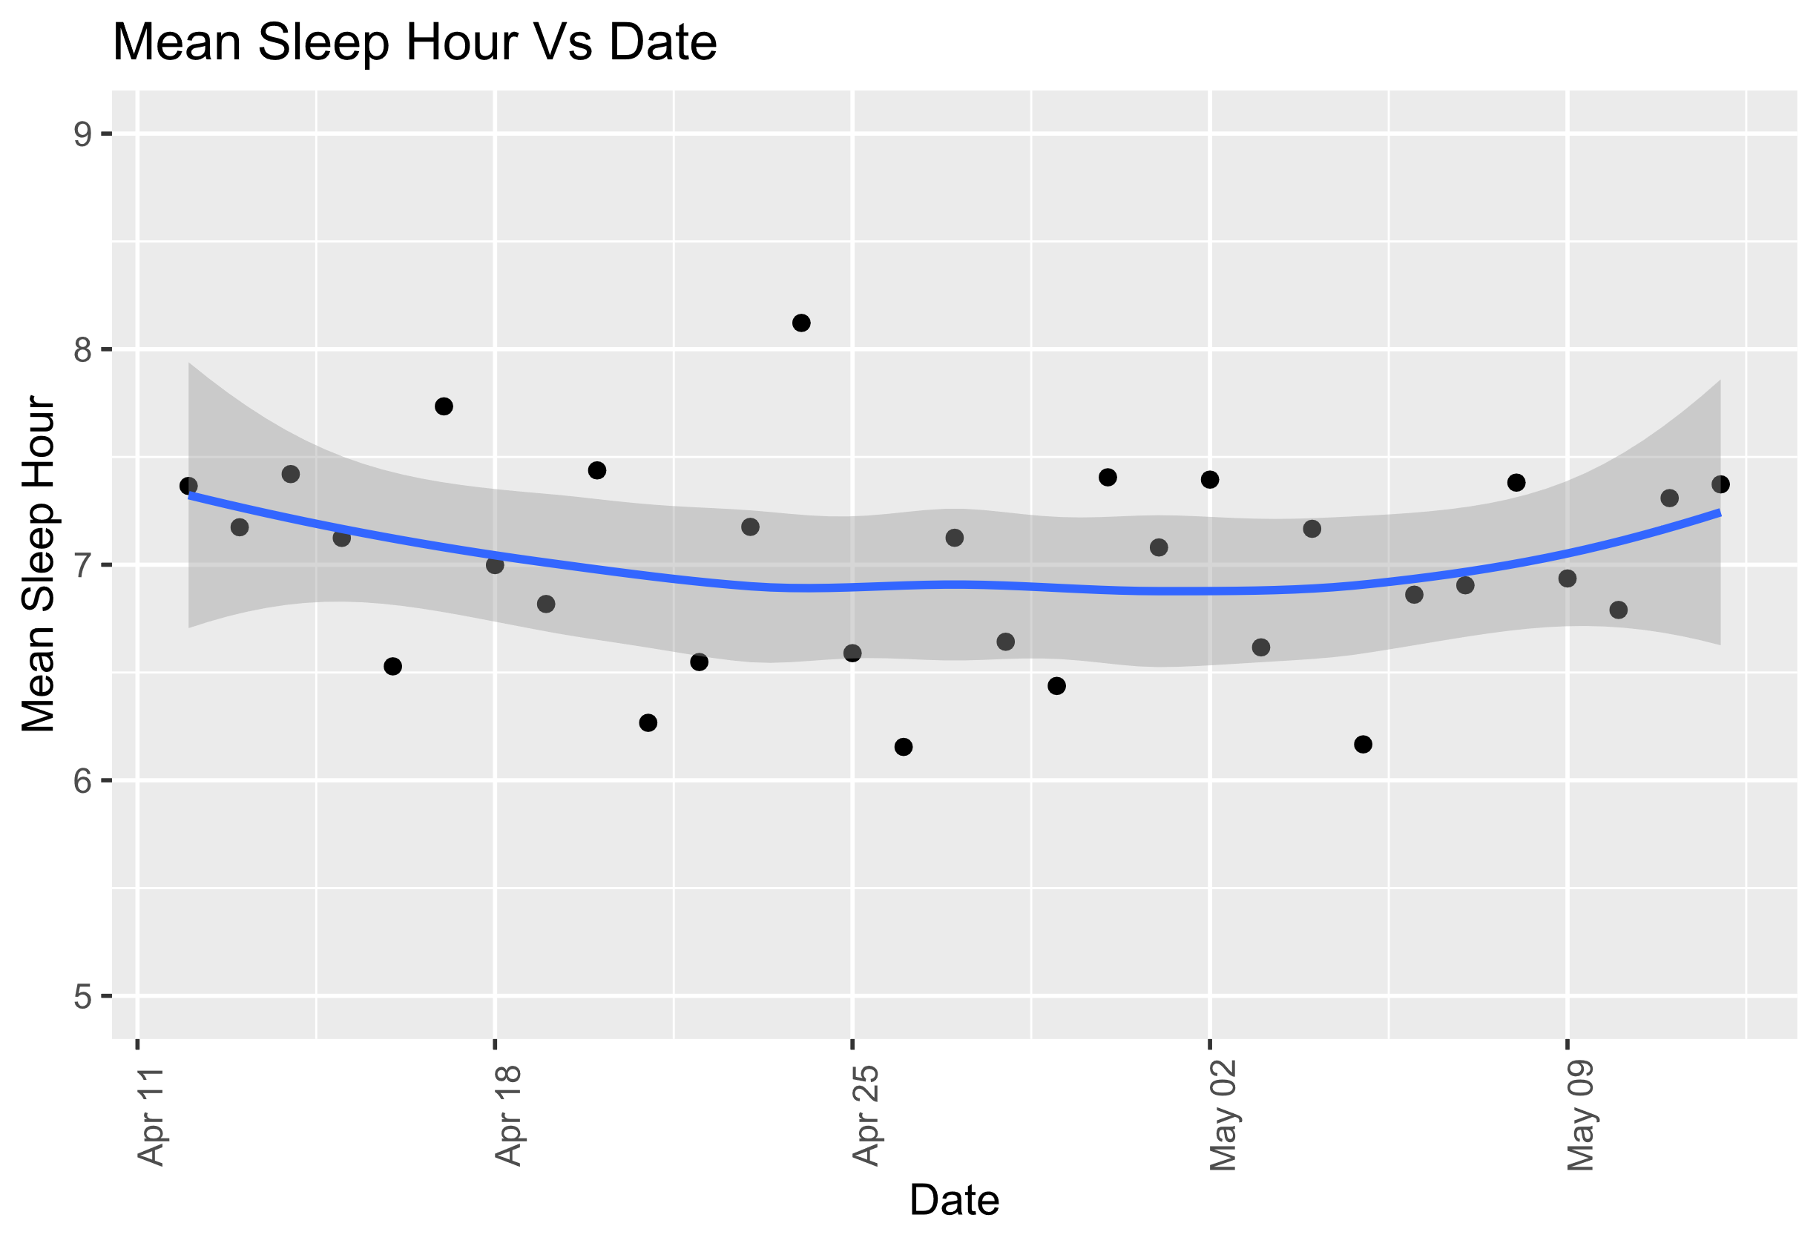
Average Sleep Per Days
Users on average have irregular sleep cycle for each day.
Also, the if the users sleep for 7 to 8 hours it would be beneficial for their health.

Slide 11
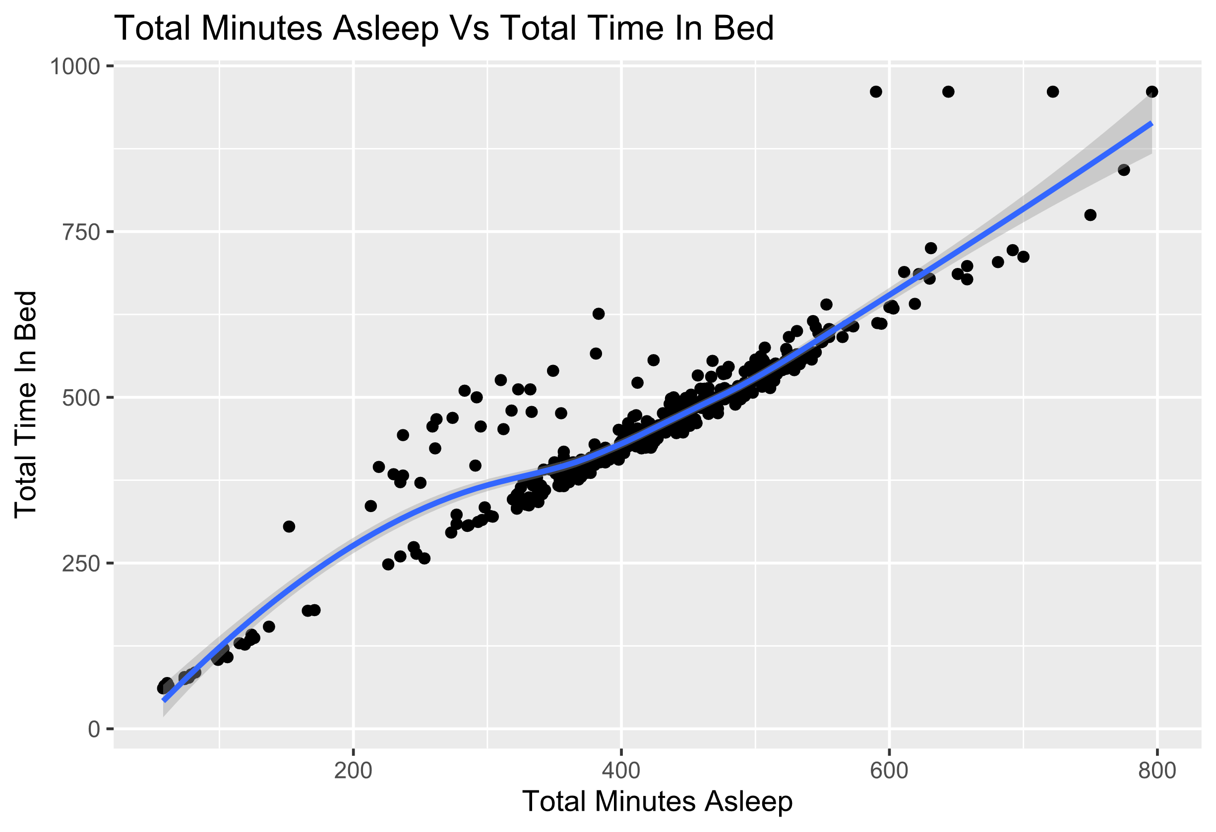
Sleep And Time In Bed
The data specifies that there is a correlation between sleep duration as well as time in bed, but in some cases, people spend a lot time in bed before sleeping.
Causes may vary, which we cannot determine from the dataset used.

Slide 12
Recommendations
The following recommendations come to mind through this analysis:
Adding Incentives for people who walk for long distances.
Developing a section which informs the users about various health related tips.
Helping users to get proper amount of sleep.

Slide 13

Thank You

Slide 14
Appendix
There is a lot of data and according to our requirement we need to have 30 ids for analysis. So, we can remove data which do not meet the criteria. We can also remove data which are redundant or not required for analysis.
After excluding the datasets which are not required, we are left with the following:
dailyActivity_merged
sleepDay_merged
hourlyCalories_merged
hourlyIntensities_merged
hourlySteps_merged

Slide 15

References
Data: Crowd-sourced Fitbit datasets 03.12.2016-05.12.2016 | Zenodo
Kaggle: FitBit Fitness Tracker Data | Kaggle

